Slide 1
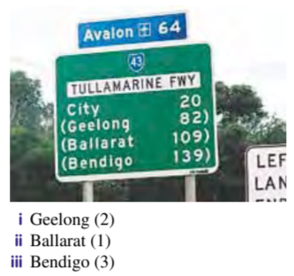
Topic: Integers
EQ: How do we use patterns of tens and ones to calculate addition problems?
Get your VIVO’s
Topic and EQ in Interactive Notebook
NO PHONES OR EAR BUDS
Complete on working-out side:
1. Give the value of the digits (in brackets) in the distances to the following destinations in these road signs. Use words to state these values
Notes:
-1+-13= -14/2=-7
7+-19= -12/2=-6

Slide 2
24
7
30
Date
Integers
EQ: How do we use patterns of tens and ones to calculate addition problems?
We are going to try adding the parts in whatever order we want and see if we can find some patterns
Collect and glue in the three column table
5

Slide 3
24
7
30
Date
Integers
EQ: How do we use patterns of tens and ones to calculate addition problems?
Add the “tens”first | Add the “hundreds ”first | Add the “ones” first
5

Slide 4
24
7
30
Date
Integers
EQ: How do we use patterns of tens and ones in a hundreds chart?
“Practice adding really large numbers” worksheet
Early finishers:
Complete “One in a million” worksheet- Activity questions with the cards. Collect blue paper and see my example. You can work in pairs.
5

